Slide 1
Panel: TEMPO Data for Extreme Events and Disasters
Gregory Frost
NOAA Office of Oceanic and Atmospheric Research

Slide 2
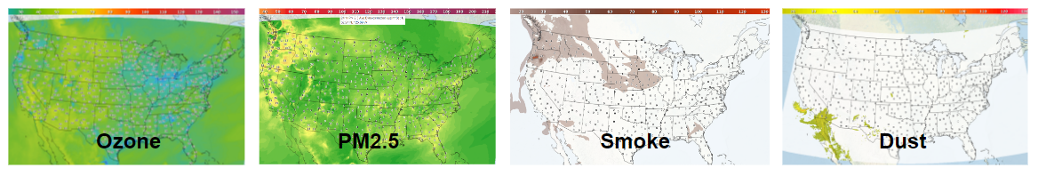
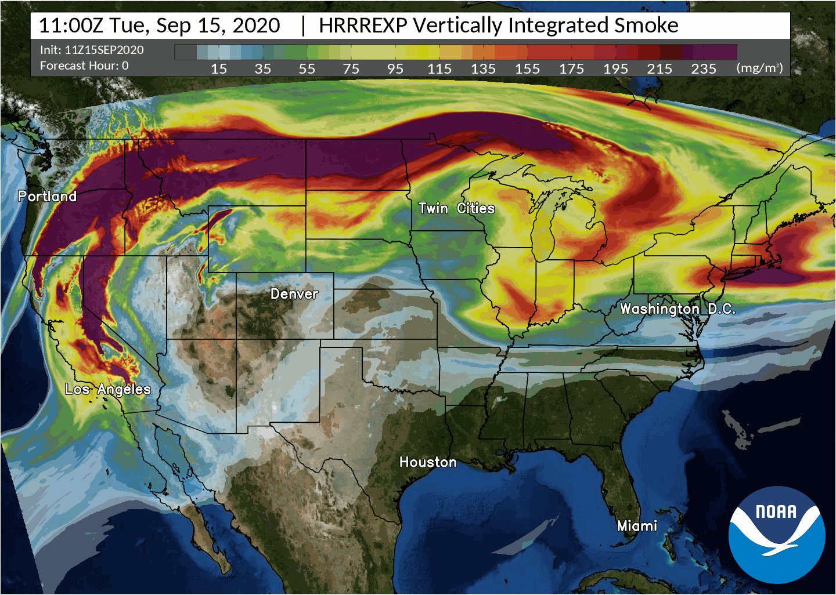
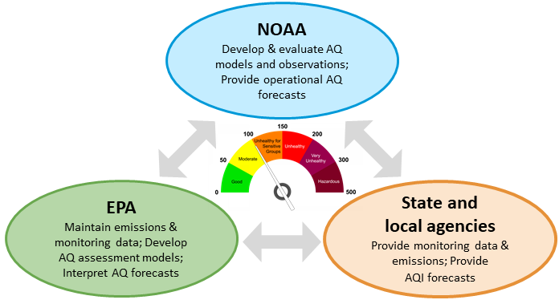
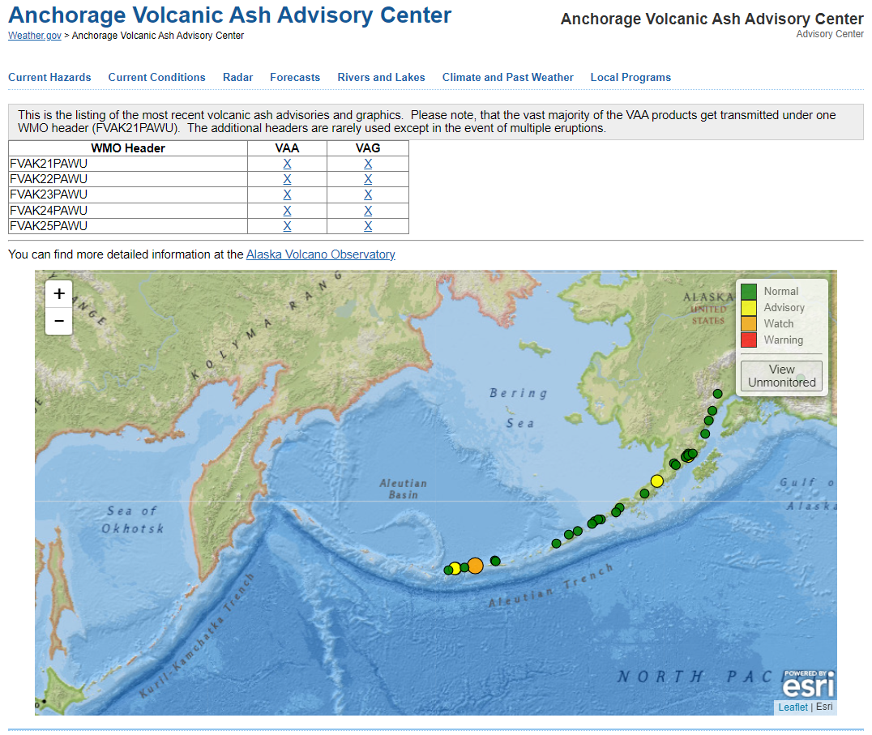
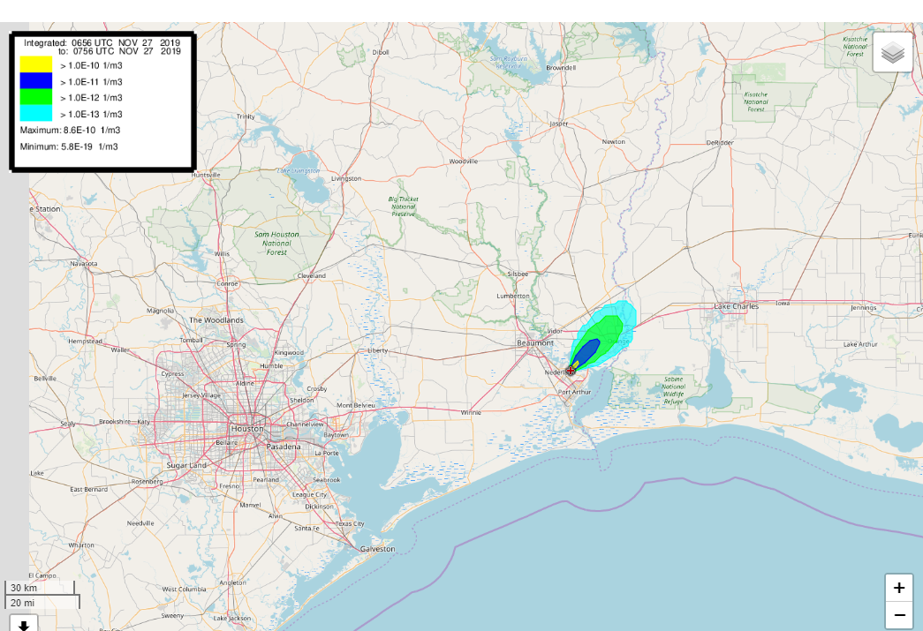
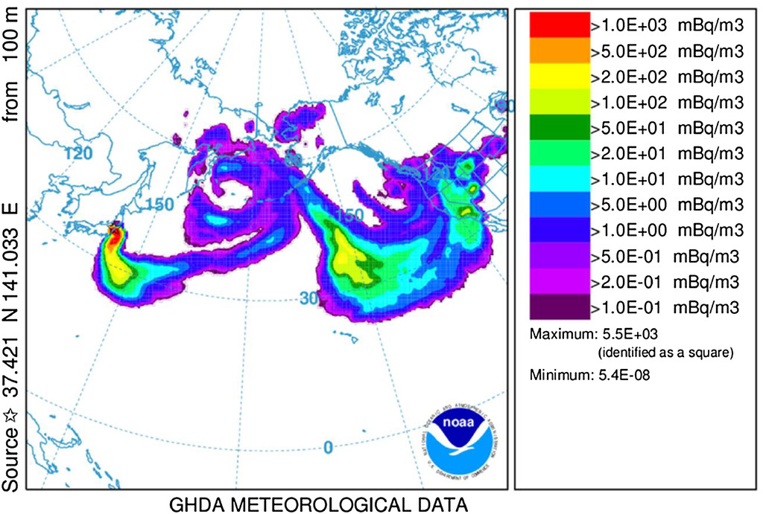
What type of extreme events or disasters are most applicable to your work?
Air quality events
Fire and smoke
Volcanic plumes
Industrial accidents
Radiological emergencies

Slide 3
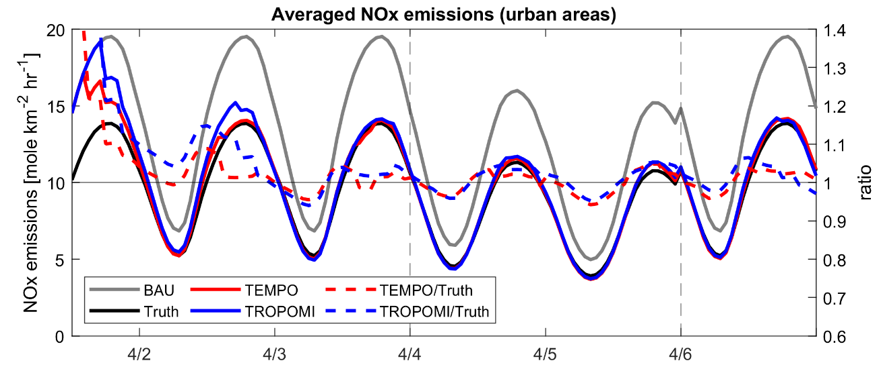

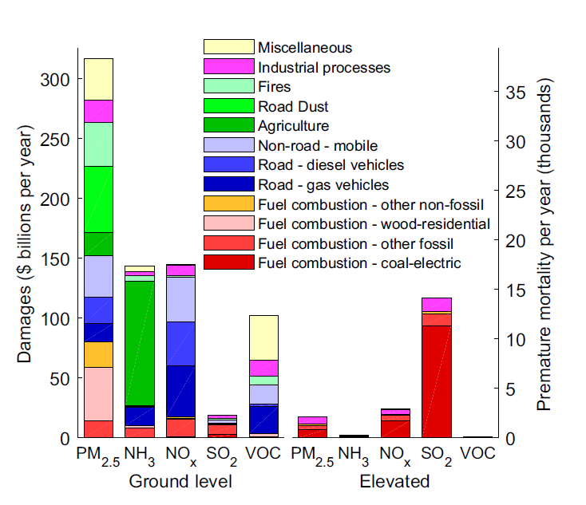
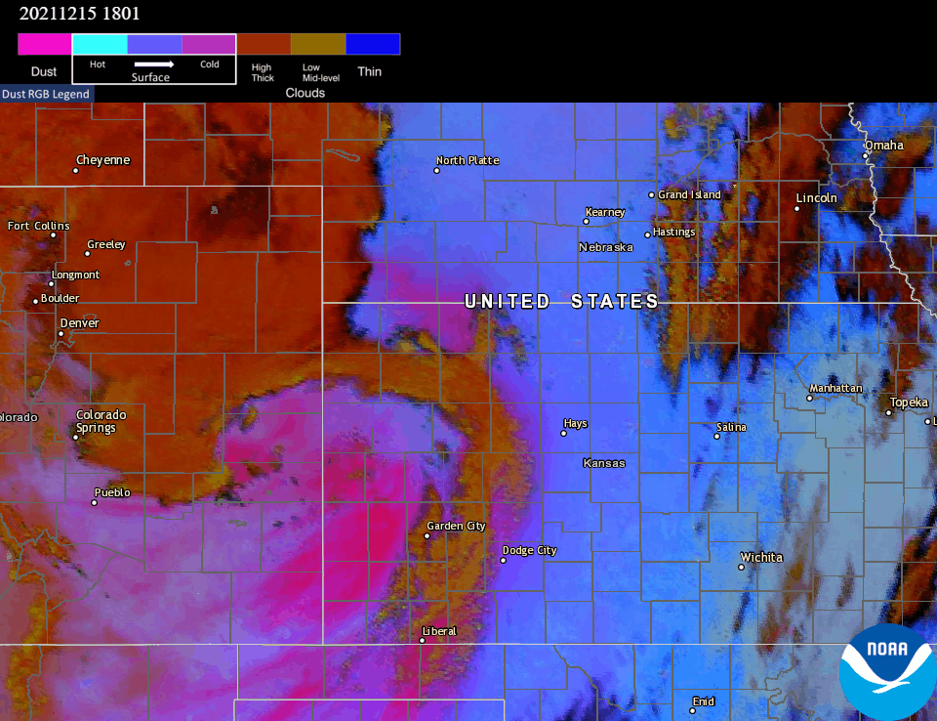
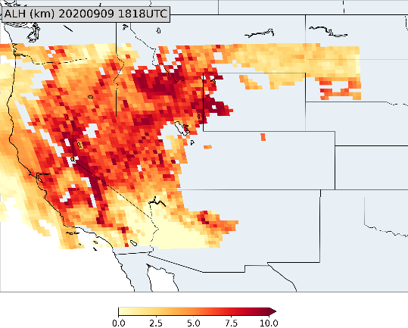
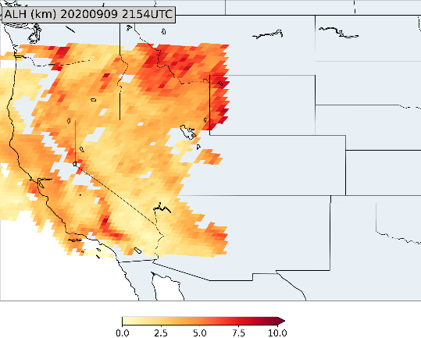
How will TEMPO data improve your current research or operations?
New enterprise products
Air quality monitoring
Near-real-time emissions
Aerosol/smoke plume height
Chemical data assimilation
Air quality forecast guidance
Exceptional events identification
Pollution exposure studies
NOx Emissions in April 2020
True = COVID-19 period, BAU = Business-as-usual,
TEMPO = BAU adjusted using TEMPO proxy data
U.S. Damages from Air Pollutants by Source
Goodkind et al., Proc. Natl. Acad. Sci., 2019
GeoXO Value Study: The Value of GeoXO Atmospheric Composition Observations for Emissions Updating and Air Quality Forecasting
PI: Brian McDonald, Co-Is: Chia-Hua Hsu, Arthur Mizzi, Daven Henze
1818 UTC
2154 UTC
ABI GXI
GXS
TEMPO ACX
GeoXO Value Study: Advancing Aerosol Layer Height Retrieval for Surface PM2.5 Monitoring
PI: Jun Wang, Co-I: Shobha Kondragunta
GOES-16 ABI dust RGB animations of 15 December 2021 “dust bowl” event (Amy Huff, NESDIS)

